Slide 1
Spring Boot 3 with Java 21
By Vivek Gohil

Slide 2
New Baseline Features of Spring Boot 3.x
Spring Boot 2.x
  Java 8 / 11 / 17 supported
Spring Boot 3.x
  Java 8 → removed
  Java 11 → removed
  Java 17+ only
Why this matters
  Enables modern JVM features
  Better GC (G1/ZGC improvements)
  Strong encapsulation
  Faster startup & lower memory

Slide 3
Spring Boot 3.x Baseline Features
Spring Boot 3.x Baseline Means:
  Java 17+
  Spring Framework 6
  Jakarta EE only
  Hibernate 6
  Standardized errors (RFC 7807)
  Built-in observability
  AOT & native readiness
  Explicit security configuration
  Fail-fast by design

Slide 4
New Baseline Features of Spring Boot 3.x
Spring Boot 3.x is built on Spring Framework 6.
What this implies
  Massive cleanup of legacy APIs
  Removal of deprecated code accumulated over years
  More predictable behavior
Impact
  Less magic
  Faster startup
  Fewer runtime surprises

Slide 5
Jakarta EE 9+ Namespace (javax → jakarta)
Spring Boot 2.x
javax.persistence.*
javax.servlet.*
javax.validation.*
Spring Boot 3.x
jakarta.persistence.*
jakarta.servlet.*
jakarta.validation.*

Slide 6
Hibernate 6 as Default JPA Provider
Spring Boot 2.x
  Hibernate 5.x
Spring Boot 3.x
  Hibernate 6.x
Baseline behavior changes
  Stricter JPQL parsing
  Better type safety
  Earlier failure (compile/startup vs runtime)

Slide 7
Problem Details (RFC 7807) for Error Handling
Spring Boot 2.x
  Custom error JSON
  Stack traces often leaked
Spring Boot 3.x
  Built-in support for RFC 7807
  Standardized error responses

Slide 8
Observability Is a First-Class Concern
Spring Boot 2.x
  Actuator + Micrometer (optional, add-on)
Spring Boot 3.x
  Observability built into the core
  Micrometer Observation API
What’s baseline now
  Tracing
  Metrics
  Context propagation
You don’t “add observability later” — it’s expected from day one.

Slide 9
AOT (Ahead-of-Time) Processing Built-In
Spring Boot 2.x
  Experimental / external tooling
Spring Boot 3.x
  AOT is part of the core build
  Native images are first-class citizens
Baseline impact
  Faster startup
  Lower memory
  Better cloud-native behavior
Even if you don’t use native images, AOT optimizations still apply.

Slide 10
Spring Security 6 Baseline
What changed fundamentally
  WebSecurityConfigurerAdapter removed
  Inheritance-based security
  Bean-based, lambda configuration
Why this matters
  Explicit configuration
  Easier to reason about
  Native-image friendly

Slide 11
Stricter Defaults & Fail-Fast Philosophy
Spring Boot 3.x:
  Fails earlier
  Logs clearer errors
  Avoids silent behavior
Examples:
  Invalid JPQL fails on startup
  Missing beans fail immediately
  Reflection misuse exposed early
Boot 3 fails early so production doesn’t fail late.

Slide 12
Spring Boot Auto-Configuration

Slide 13
Spring Boot Auto-Configuration
Auto-configuration moved from reflection-heavy discovery to declarative imports.

Slide 14
What This Means in Simple English
In Spring Boot 2.x
  Spring Boot scanned and inspected a lot of classes at runtime to figure out which auto-configurations to apply.
In Spring Boot 3.x
  Spring Boot is now told explicitly which auto-configurations exists, so it import them directly instead of discovering them
  In short Less guessing and more explicit instructions

Slide 15
How Auto-Configuration Worked in Spring Boot 2.x
Mechanism : spring.factories
META-INF/spring.factories
Example
org.springframework.boot.autoconfigure.EnableAutoConfiguration=\
org.springframework.boot.autoconfigure.jdbc.DataSourceAutoConfiguration,\
org.springframework.boot.autoconfigure.orm.jpa.HibernateJpaAutoConfiguration

Slide 16
What happens at runtime?
Boot reads spring.factories
Loads all listed class names
Uses reflection to:
  Load classes
  Inspect annotations
  Evaluate conditions
Decides which configs apply
Why this is reflection-heavy
  Classes are loaded even if they won’t be used
  Reflection is used to inspect:
    Annotations
    Constructors
    Bean methods
Happens at startup

Slide 17
Problems With Reflection-Heavy Discovery
Performance cost
  Slower startup
  More memory usage
Hard for native images
  Reflection must be declared in advance
  Dynamic discovery breaks GraalVM
Harder to analyze
  Tools can’t easily see what will be loaded
  Debugging auto-config order is painful

Slide 18
How Auto-Configuration Works in Spring Boot 3.x
Mechanism: Declarative Imports
META-INF/spring/org.springframework.boot.autoconfigure.AutoConfiguration.imports
Example
org.springframework.boot.autoconfigure.jdbc.DataSourceAutoConfiguration
org.springframework.boot.autoconfigure.orm.jpa.HibernateJpaAutoConfiguration

Slide 19
What happens at runtime?
Boot reads a simple list
Directly imports listed configurations
Applies conditions without scanning
No runtime guessing
It’s like a precomputed index.

Slide 20
Why This Matters (Very Important)
Faster startup
  Less reflection
  Less class loading
Better tooling
  IDEs understand auto-config better
  Build tools can analyze dependencies
Cloud & Native Ready
  Required for AOT
  Required for GraalVM native images
Predictable behavior
  No hidden auto-configurations
  Fail-fast when misconfigured

Slide 21
Visual Comparison
Aspect | Spring Boot 2.x | Spring Boot 3.x
Discovery | Runtime scanning | Pre-declared imports
Mechanism | spring.factories | AutoConfiguration.imports
Reflection | Heavy | Minimal
Startup speed | Slower | Faster
Native image | Hard | First-class

Slide 22
GraalVM

Slide 23
GraalVM
GraalVM is a high performance JDK that speeds up the performance of Java and JVM-based applications and simplifies the building and running of Java cloud native services.
The optimized compiler generates faster code and uses fewer compute resources, enabling applications start instantly.

Slide 24
GraalVM : Questions
Why we need to use GraalVM, when I am good with traditional JDKs?
  Businesses want to deliver innovative software that scales and automates processes, while also running and consuming fewer resources.
  Organizations are moving applications to the cloud and adopting cloud-native architectures like microservices, serverless to reduce costs and improve efficiency.

Slide 25
What happens inside normal JDK?
Java
Code
javac Hello.java
.class
java Hello
JVM
Output
Output

Slide 26
What happens inside JVM?
Class Loading
  The JVM starts by loading the necessary classes and resources required by the program.
  It searches for bytecode files(.class) that correspond to the classes used in the program and loads them into memory.
Bytecode Verification
  Once the classes are loaded, the JVM preforms bytecode verification. It checks the bytecode for any violations of the Java language specification.
  This step ensures the safety and security of the JVM by preventing the execution of malicious or malformed bytecode.
Just-In-Time(JIT) Compilation
  After the bytecode is verified, the JVM employs a Just-In-Time(JIT) compiler to convert the bytecode into machine code. The JIT compiler analyzes the bytecode and identifies portions of the code that are frequently executed, known as hot spots.
  It optimizes the hot spots by translating them into highly optimized machine code, specific to the underlying hardware and operating system.
  This compilation process is known as dynamic or on-the-fly compilation because it happens during runtime.
Execution
  Once JIT compilation is completed, JVM starts executing the optimized machine code.
  It interprets the bytecode and executes the corresponding instructions. At this stage, the Java program is running natively on the underlying hardware, similar to programs written in other programming languages.

Slide 27
What happens with GraalVM
JIT mode
Java
Code
javac Hello.java
.class
java Hello
GraalVM
JIT
Output
Output
AOT mode
Java
Code
javac Hello.java
.class
native-image Hello
GraalVM
AOT
Native executable code
./hello
Output
GraalVM includes a Native utility to compile applications ahead-of-time(AOT) into native executables. The executables
are smaller, start nearly instantaneously, and consume a fraction of the compute resources needed to run the same java
application on a Java Virtual Machine. It makes GraalVM ideal for cloud deployments and microservices.

Slide 28
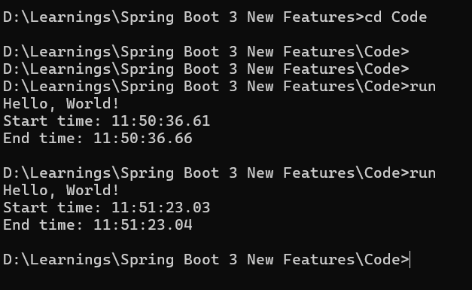
GraalVM : HelloWorld Demo

Slide 29
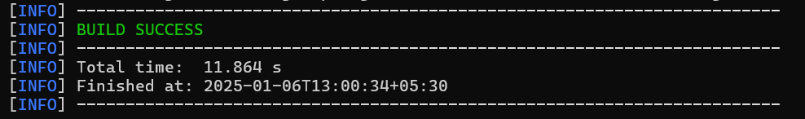
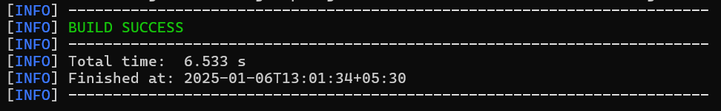
GraalVM : Spring Boot – JIT Compilation

Slide 30
What happens in GraalVM AOT mode?
Iterative static analysis of the code will be done
by GraalVM until fixed point reached.
GraalVM scans all the reachable classes, method etc. Any unused code will be ignored
Any dynamic code invoked with reflection,JNI, Dynamic proxy etc can’t analysed by GraalVM since it performs static analysis. To overcome this, we need to provide Reachability Metadata to GraalVM
Application classes
Libraries
native-image
Ahead-of-time
compilation
Native executable code
Output
JDK
Substrate VM

Slide 31
Advantages ofGraalVM
Apps start instantly
  JIT – Normal Just In Time Compilation
    Load JAR files from disk
    Extract class files
    Verify class definitions
    Interpreter logic
    Profiling
    Compile to machine code
    Initiate the start process with full speed
  AOT – Ahead Of Time Compilation
    Load native executable code from disk
    Initiate the start process with full speed
Since the number of steps with GraalVM is less and code is ready for execution in native format, the start time will be less compared to traditional JDK

Slide 32
Advantages ofGraalVM
Low memory consumption
  Save Cloud Bill
Compact packaging
  Save Cloud Bill
Reduced Attack Surface
  Only code reachable by the application are included in the image and no new code can be loaded at runtime.
  Reflection, Deserialization etc are disabled and require explicit reachability metadata configuration
Polyglot support

Slide 33
Limitation of GraalVM
GraalVM static analysis may not automatically detected all reflection code, JNI, Dynamic proxy code. Workaround is to provide this information manually to the GraalVM using Reachability metadata.
Maintaining Reachability metadata for our own application code is file, but how about the dynamic code used in libraries and frameworks?
  The solution is, all major frameworks like Spring Boot , Quarkus , Micronaut, Helidon are already updated their code to provide this Reachability metadata.
Need lot of computational efforts at build time. Make sure to use a powerful machine with the same platform target and OS. You can’t build on windows and deploy the executables code into Linux server
During local development and unit testing, it will be annoying to use AOT because it takes lots of time to generate native executable code. Instead use JIT and go for AOT only during the final build process.

Slide 34
Different types of Threads
Kernel/OS Thread
  This is also known as OS Thread.
  Kernel Threads are managed and scheduled by the operating system
Platform Thread
  Each Java platform thread is associated 1-to-1 with an OS OR kernel thread

Slide 35
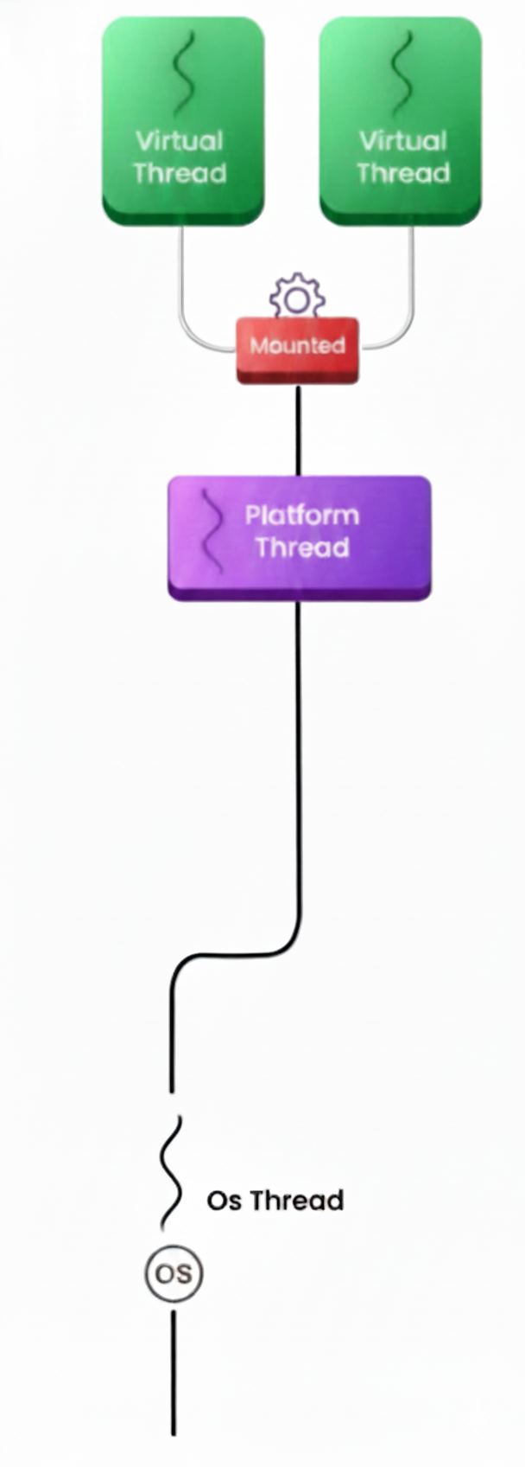
Virtual Threads
A Virtual Thread is a lightweight thread managed by the JVM instead of operating system.
It looks like a normal Java thread but internally
  Scheduled by the JVM
  Extremely cheap to create
  Can block without wasting OS resources

Slide 36
Compare with Platform Thread
Aspect | Platform Thread | Virtual Thread
Backed by | OS thread | JVM scheduler
Creation cost | Expensive | Very cheap
Count | Hundreds / thousands | Millions
Blocking | Wastes OS thread | JVM parks it
Used in | Java since day 1 | Java 19 (Loom)

Slide 37
Why do we need Virtual Threads ?
16 GB RAM
1 Thread = 20 MB
I can create around 800 Threads. (16 *1024 /20)
Single request processing time = 100 ms
Request Preparation
0.1 ms
IO (Database,Disk) Operations
100 ms
Response Preparation
0.1 ms
800 Concurrent Requests
1 Request = 1 Thread
Total CPU time for processing single request =
0.1 ms + 0.1 ms = 0.2 ms
Total Requests are 800 = 800 * 0.2 ms = 160 ms
CPU utilization of 1 second = 160 ms / 1000 ms = 16
CPU utilization = 16%
We are not optimally utilizing the CPU to its capacity

Slide 38
Why do we need Virtual Threads ?
16% = 800 Threads
How many threads do we need to create in order to utilize 90% CPU
Number of threads required = 800 * 90 / 16 = 4500 threads
How much RAM is required for same = 4500 * 20 = 90 GB

Slide 39
Actuator
Spring Boot Actuator provides production-ready endpoints to monitor and manage applications.
What changed in Spring Boot 3
  Better defaults
  Stronger security
  Improved health model
  Observability alignment
Actuator is no longer an afterthought.

Slide 40
Observability and Monitoring
Monitoring performance of service calls
  We can track the path of a specific chain service call through our service network and see how long it took to complete at each service.
Monitoring services metrics and health
  We can easily and efficiently monitor the metrics like CPU usage, JVM metrics
  We can monitor the status and health of all our endpoints in a single place and create alerts and notifications for any abnormal behaviour of the services

Slide 41
What is Observability ?
Observability is the ability to understand the internal state of a system by observing its outputs.
In the context of Spring Boot microservices observability is achieved by collecting and analysing data from variety of sources such as metrics logs and traces.

Slide 42
The Three pillars of Observability
Metrics
  Metrics are quantitative measurements of the health of a system.
  They can be used to track things like CPU usage, memory usage and response time.
Logs
  Logs are a record of events that occur in a system.
  They can be used to track things like errors, exceptions and other unexpected events
Traces
  Traces are a record of the path that a request takes through a system.
  The can be used to track the performance of a request and identify bottlenecks

Slide 43
The Three pillars of Observability
By collecting and analysing data from these three sources, you can gain a comprehensive understanding of the internal state of your application.
This understanding can be used to identify and troubleshoot problems, improve performance and ensure the overall health of your system.

Slide 44
What is Monitoring ?
Monitoring in microservices involves checking the telemetry data available for the application and defining alerts for known states.
This process collects and analyses data from a system to identify and troubleshoot problems as well as track the health of individual microservices and overall health of the microservices network

Slide 45
Monitoring is important because
Identify and troubleshoot problems
  By collecting and analysing data from your service, you can identify problems before they cause outages or other disruptions.
Track the health of your application
  Monitoring can help you to track the health of your application, so you can identify any service that are underperforming or that are experiencing problems
Optimize your service
  By monitoring your application/service, you can identify areas where you can optimize your application/service to improve performance and reliability.

Slide 46
Logging
Logs are essential tools for troubleshooting and debugging tasks.
They can be used to reconstruct what happened at a specific point in time in a single application instance.
Logs are typically categorized according to the type of severity of the event such as trace, debug, info, warn and error.
This allow us to log only most severe events in production while still giving us the chance to change the log level temporarily during debugging

Slide 47
Managing logs with Grafana, Loki and Promtail
Grafana is an open source analytics and interactive visualization web application.
It provides charts, graphs and alerts for the web when connected to supported data sources,
It can be easily install using Docker or Docker Compose
Grafana is a popular tool for visualizing metrics, logs and traces from a variety of sources.
It is used by organization of all size to monitor their applications and infrastructure.

Slide 48
Managing logs with Grafana, Loki and Promtail
Grafana Loki is a horizontally scalable, highly available and cost effective log aggregation system.
Promtail is a lightweight log agent that ships logs from your container to Loki. It is easy to configure and can be used to collect logs from a wide variety of sources.
Together, Grafana Loki and Promtail provide a powerful logging solution that can help you understand and troubleshoot your application.
Grafana provides visualization of the log lines captured within Loki.

Slide 49
Managing logs with Grafana, Loki and Promtail
Spring Boot Application
Grafana
Query, Search, Visualize logs with Loki as datasource
Query and Search Logs
Fetches Log
Promtail
Collects logs from containers, process & forwards to Loki
Forward Logs
Loki
log aggregation system

